Slide 1


Here's your outline to get started
Key facts about your topic
Hampi or Hampe, also referred to as the Group of Monuments at Hampi, is a UNESCO World Heritage Site located in east-central Karnataka, India. It became the pilligrimage centre of the Hindu religion. Vijayanagara Empire capital in the 14th century. Chronicles left by Persian and European travellers, particularly the Portuguese, state Hampi was a prosperous, wealthy and grand city near the Tungabhadra River, with numerous temples, farms and trading markets. By 1500 CE, Hampi-Vijayanagara was the world's second-largest medieval-era city after Beijing, and probably India's richest at th...
Local time: India Standard Time
Location: 15.32681°N 76.46696°E
Points of interest: Virupaksha Temple, Vitthala Temple, Sasivekalu Ganesha Temple, Achutaraya Temple, Elephant Stables, Lotus Mahal, Hema...
See more: Open the Notes below for more information.
Notes:
QuickStarter has created an outline to help you get started on your presentation. Some slides include information here in the notes to provide additional topics for you to research.
Summary:
Hampi or Hampe, also referred to as the Group of Monuments at Hampi, is a UNESCO World Heritage Site located in east-central Karnataka, India. It became the pilligrimage centre of the Hindu religion. Vijayanagara Empire capital in the 14th century. Chronicles left by Persian and European travellers, particularly the Portuguese, state Hampi was a prosperous, wealthy and grand city near the Tungabhadra River, with numerous temples, farms and trading markets. By 1500 CE, Hampi-Vijayanagara was the world's second-largest medieval-era city after Beijing, and probably India's richest at that time, attracting traders from Persia and Portugal.The Vijayanagara Empire was defeated by a coalition of Muslim sultanates; its capital was conquered, pillaged and destroyed by sultanate armies in 1565, after which Hampi remained in ruins.
More key facts:
Points of interest: Virupaksha Temple, Vitthala Temple, Sasivekalu Ganesha Temple, Achutaraya Temple, Elephant Stables, Lotus Mahal, Hemakuta Hill Temple Complex, Hazara Ram Temple, Monolithic Bull, Queen's Bath, Pampa Sarovar, Zanana Enclosure

Slide 2

Related topics to research
Vijayanagara Empire
Ajanta Caves
Konark Sun Temple
Sanchi
Krishnadevaraya
Mysore Palace
Taj Mahal
Gol Gumbaz
Red Fort
Rani ki vav
Use Smart Lookup to learn more
1
Highlight one of the related topics
Right-click on the topic
Choose "Smart Lookup"
2
3

Slide 3

This Photo by Unknown Author is licensed under CC BY-SA-NC

Slide 4
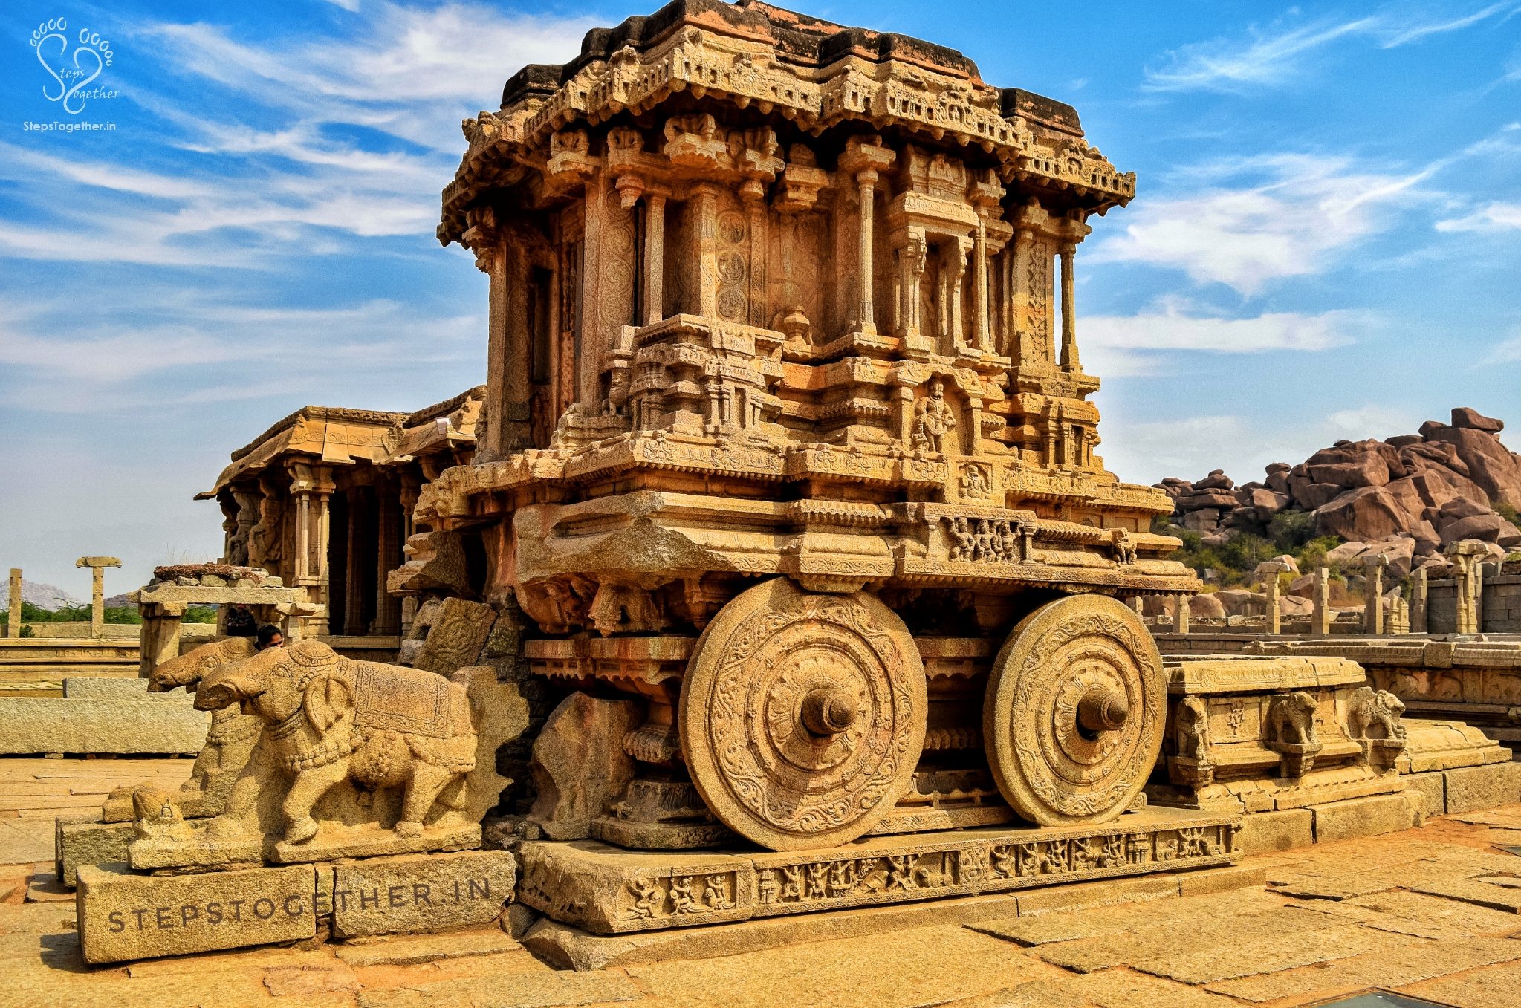
Hampi
By:Hitesh

Slide 5

Contents
Hampi
__________________
Hampi, lays at the center of Vijayanagara, the capital of the Vijayanagara empire. It is a well-fortified city, revealed by the magnificent ruins at Hampi.
The breath-taking palaces and huge temples, all of which were profusely decorated with carvings, sculptures, and paintings. The construction of walls was done using a technique in which stone slabs were wedged together by interlocking. No mortar or cementing agent was used in this construction.
Hampi had a distinctive architecture. The city which was a hub of various activities during the fifteenth and sixteenth centuries
Etymology
Location
Texts and history
Description

Slide 6
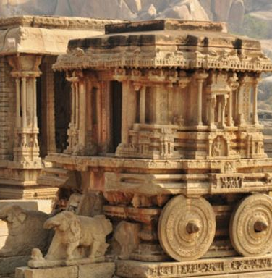
Why is Hampi in Ruins?
The vijayanagara empire defeated by the Deccan Sultans (the rulers of Golconda, Ahmednagar, Berar, and Bidar).
When the Vijayanagara Empire was defeated, the city of Hampi was destroyed and was left in ruins .About the ruins, historian Sewell says, 'Never perhaps in the history of the world has such chaos been wrought on a splendid city, teeming with wealthy and industrious people.’

Slide 7
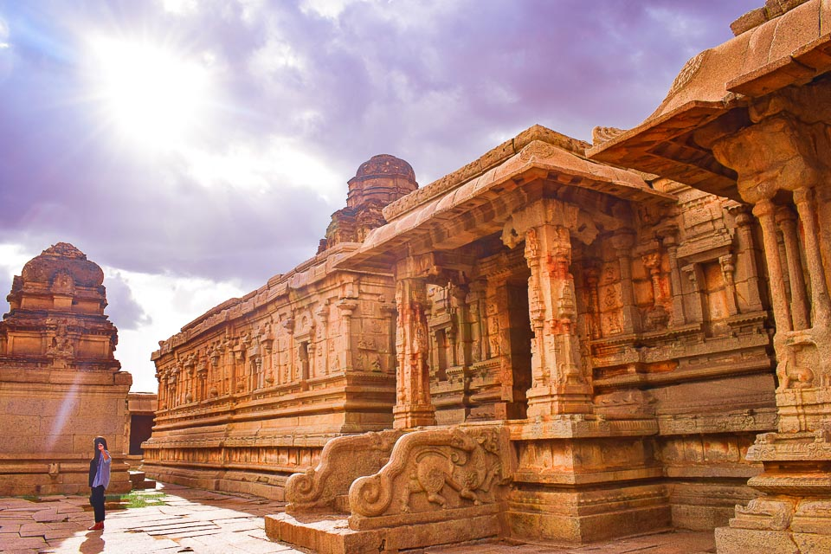
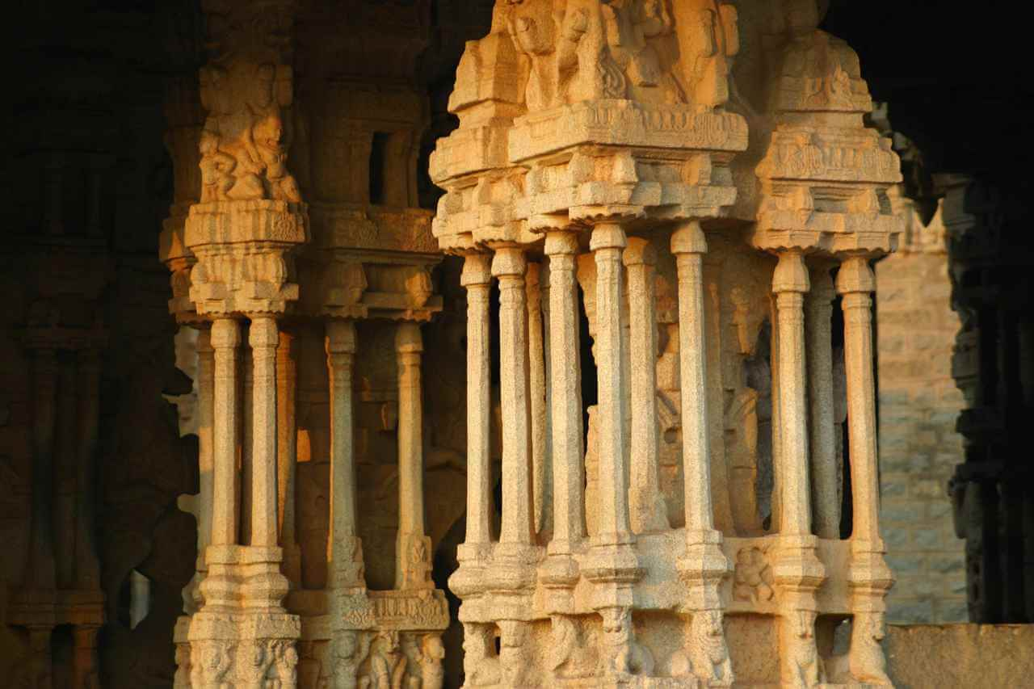
A Few Facts:
The Vittala temple in Hampi is famous for its marvelous architecture. It is also known for another extraordinary architectural marvel – 56 melodic columns or musical pillars. These pillars create melodic sounds when tapped delicately. The most intriguing thing is that the columns are constructed using stones. The melodic mainstays of Vittala Temple are also called ‘SAREGAMA ‘pillars.
Notes:
Consider talking about:
Ancient to 14th century CE
14th century and after
Archaeological site

Slide 8
Fact two:
Hampi is a historic city, but throughout history, people have considered the place sacred for many reasons. It also holds great importance in the Hindu epic Ramayana. It is believed to be the monkey kingdom Kiskinda, where Lord Ram met his loyal follower Hanuman. The monkey army later helped Rama build a bridge of stones across the sea to help him reach Lanka.No wonder the stories inspired so many temples and the stone carvings on them.
Notes:
Consider talking about:
Ancient to 14th century CE
14th century and after
Archaeological site

Slide 9



A FEW PHOTOS

Slide 10
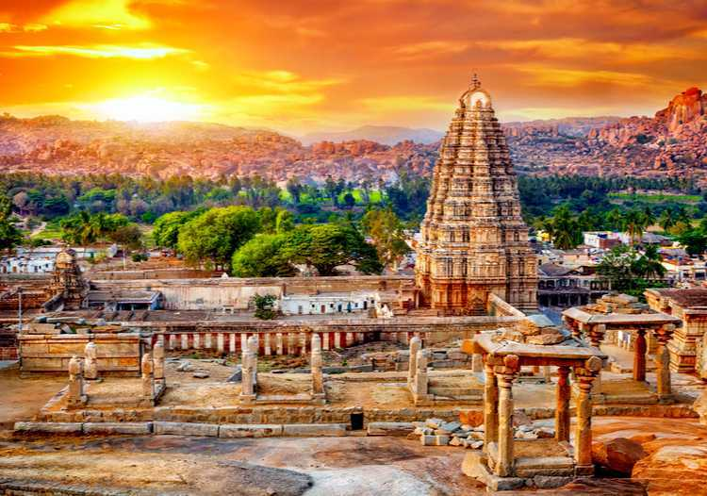
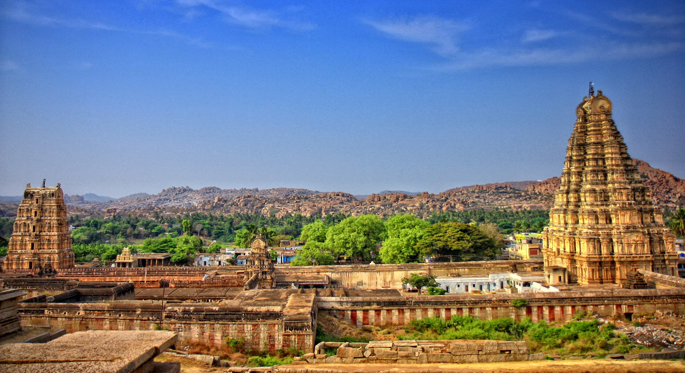

Slide 11
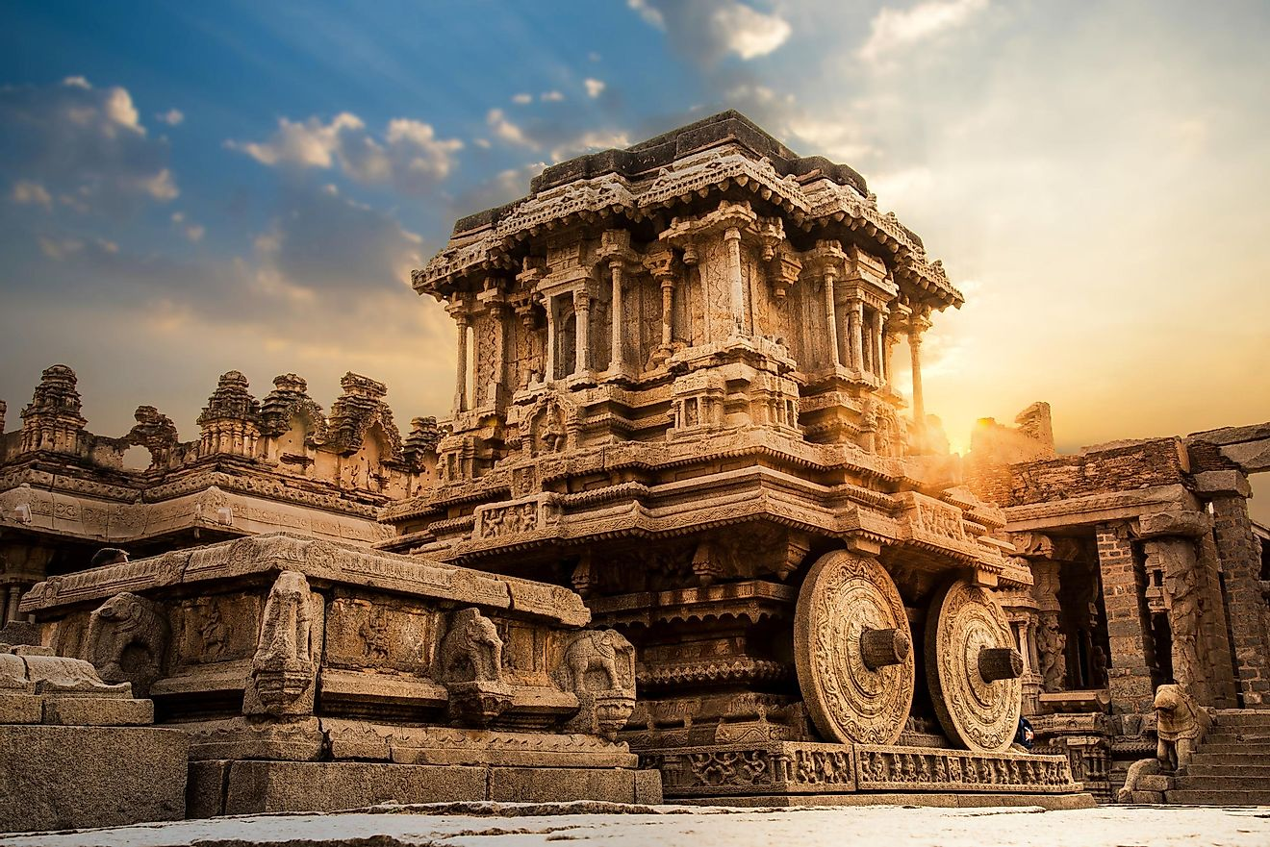

Slide 12
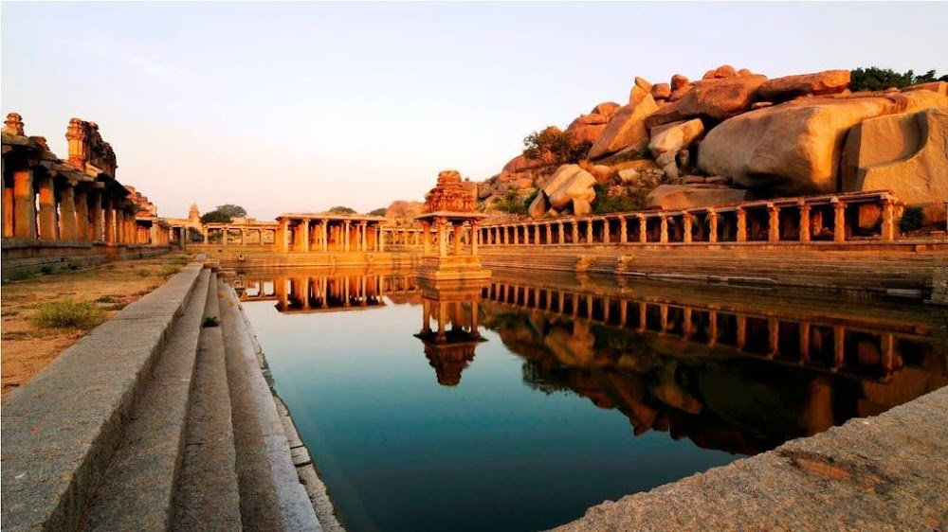

Slide 13




